Slide 1

Regulatory Updates for Insurers
Deloitte & Touche House
Thursday, 12 February

Slide 2
Agenda - Introduction Glenn Gillard, Partner - Regulatory Developments Sinead Ovenden, Director - Data Protection For the Insurance Sector - Recent Code of Practice Gary Comiskey, Senior Manager - Q&A & Close

Slide 3
Regulatory Developments Sinead Ovenden, Director

Slide 4
Agenda
Financial Regulator Activity
Consumer Protection Code
Review of Intermediary Market
Anti Money Laundering 3rd Directive
Solvency II
Payment Protection Insurance
Compliance Framework

Slide 5
1. Financial Regulator Activity
Values
Set and monitor standards in dealing with customers
Set and monitor standards in managing your business
Provide information to customers
Facilitate innovation and competitiveness
Maximise operational efficiency and cost effectiveness
Focus
Monitoring compliance – themed reviews, onsite visits, mystery shopping
Customers – increase in consumer protection – new Code
Business – significant increase in prudential reporting requirements
Information – itsyourmoney.ie
Competitiveness – publication of cost comparison surveys

Slide 6

1. Financial Regulator Activity 2008 agenda
Inspections target for 2008
8 themed inspections in relation to CPC
100 on-site inspections
Settlements and fines
10 settlements, 8 fines total value €3.63million
Compare to:
- 4 settlement in 2007, one fine of €5k
- 2 settlement in 2006, no fines

Slide 7
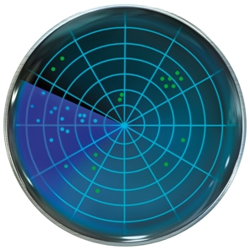
5. Solvency II
CEIOPS
Published its fourth Quantitative impact study
Results showed that measured against the level of stress embedded in the QIS4 simulations, for year end 2007, the European insurance industry appeared to be well capitalised.
Insurance Group Supervision Committee - published work plan for 2009
Priorities for 2009 include:
delivery of Level 2 measures (19 work streams)
continue to focus on supervision of cross border insurance groups feeding into supervisory colleges)
support CEIOPS training activities

Slide 8

6. Payment Protection Insurance
January 2009
UK Competition Commission
Market investigation into PPI
Findings:
PPI sales face little competition when sold with credit
Consumers face higher prices
Less choice
Highly profitable product for distributers
Profitability used to subsidise credit process
Conclusion:
Prohibition on selling PPI to credit customers within 7 days of credit sale
Prohibition on single premium PPI
Requirement to offer PPI separately as opposed to bundled
Additional information requirements in marketing material

Slide 9

6. Payment Protection Insurance News
20 January 2008
FSA welcomed UK banks move to stop selling single premium payment protection Insurance with unsecured personal loans by end January 2009:
Alliance & Leicester
Barclays
The Co-Operative Bank
Lloyds Banking Group (incl Lloyds TSB, Halifax, Bank of Scotland)
RBS/Natwest
“A PPI product can be helpful for customers wanting protection on a specific creduit agreement, as long as the policy is sold appropriately. Consumers can

Slide 10
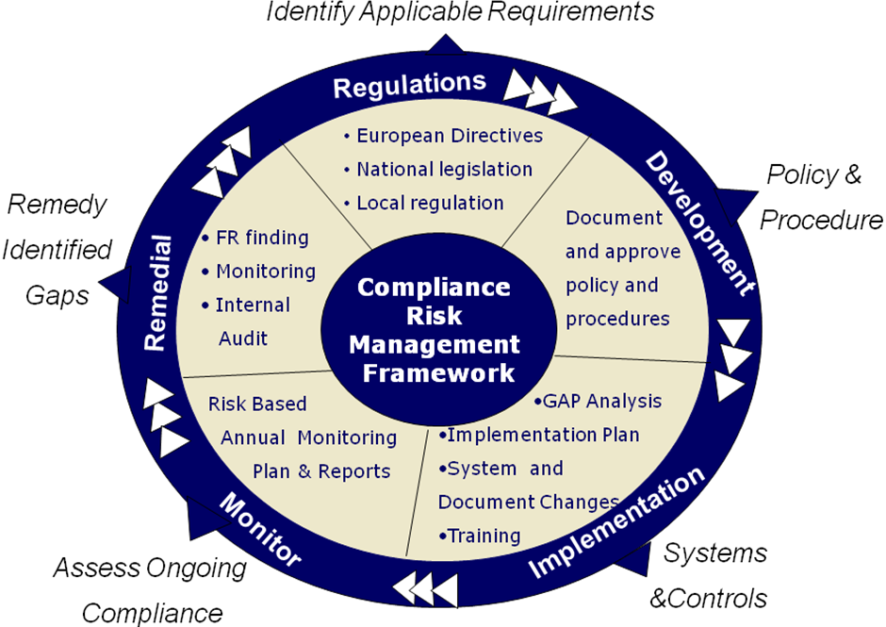
7. Compliance Framework Our solution

Slide 11
Data Protection For the Insurance Sector – Recent Code of Practice Gary Comiskey, Senior Manager

Slide 12
Overview
Re-Cap on the Eight Rules of Data Protection
Changes in the New Code of Practice
Key Challenges to Compliance
Compliance Tips
12

Slide 13
Eight Rules of Data Protection
Obtain and process information fairly
Keep it only for one or more specified, explicit and lawful purposes.
Use and disclose it only in ways compatible with these purposes.
Keep it safe and secure.
Keep it accurate, complete and up-to-date.
Ensure that it is adequate, relevant and not excessive.
Retain it for no longer than is necessary for the purpose or purposes.
Give a copy of his/her personal data to that individual, on request.
13

Slide 14

Code of Practice on Data Protection for the Insurance Sector
14

Slide 15
Obtain and process information fairly
Appropriate details on application forms
Consent from third parties
Insurance pre-claim data should not be collected
Develop a written privacy policy
Provide a privacy statement on websites
Advise customers in relation to telephone recording
Explicit consent for sensitive data AND this data must be subject to appropriate security
Private Investigators should comply with DP rules
Example of level one text (Arial 24pt)
Example of first level bullet (Arial 24pt)
Example of highlighted first level bullet (Arial 24pt)
Example of second level bullet (Arial 24pt)
Example of third level bullet (Arial 20pt)
Example of fourth level bullet (Arial 20pt)
15

Slide 16
Keep it only for one or more specified, explicit and lawful purposes
Keep data for purposes that are specific, lawful and clearly stated.
New guidance in relation to the collection of data for “secondary purposes”.
None incepted quotes only kept for 15 months
Use and disclose it only in ways compatible with these purposes
Data should only be disclosed to authorised persons.
16

Slide 17
Keep it safe and secure
Appropriate security measures should be in place - Particular focus on portable devices
Appropriate procedures in relation to back-up of data
Logging and auditing of access to data
An appropriate external access policy
Implement a confidentiality policy
17

Slide 18
Keep it accurate, complete and up-to-date
_____ ____ ___ ____ ____ __ ________ ________ ___ __ __ ____
___ ___________ __________ __ _____ __ _____ ___ ________ __ ___________ _________ ___ _____
_____ ____ __ __ ________ ________ ___ ___ _________
_____ ____ ____ ________ ___________ __ ______ ___ ________
______ ___________ ________ ____ ____ __ ____ __ __________ ___ _________ ___________
Ensure that all data kept is accurate, complete and up-to-date
Have appropriate procedures in place to check the accuracy of information following its entry.
Ensure that it is adequate, relevant and not excessive
Ensure that only relevant information is sought and provided.
Medical information provided will only be used to underwrite the proposers application.
18

Slide 19
Retain it for no longer than is necessary for the purpose or purposes
Insurers will have a written data retention policy.
Policyholder information will be held for 6 years after the ending of the relationship.
Limited policyholder information may be held for longer periods
Non incepted life policies may be for 6 years.
19

Slide 20
Give a copy of his/her personal data to that individual, on request
Procedures to deal with subject access requests
Special provision for medical information requests
Limited circumstances where persons will not be permitted to see information
20

Slide 21
Special provisions relating to genetic test results
The processing of genetic data in relation to insurance is prohibited
An Insurer will not request an applicant to have a genetic test
Forms which ask health questions directly of the individual must include a form of words bringing to his/her attention the fact that he/she should not disclose a genetic test result
In the event of a genetic test result coming into the possession of an insurer, the genetic test result must be ignored and not taken account of by the insurer
21

Slide 22
Key Compliance Challenges
22

Slide 23
Key Challenges
Securing “buy-in” from senior management
The need to understand the data held within the organisation
Training and awareness for staff
Using the right technology solutions
Embedding Data Protection into the organisation
23

Slide 24
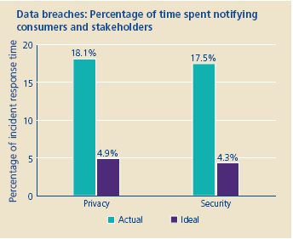
Recent Deloitte Survey
66.4% of respondents experienced between 6 and 20 incidents and 12.3% indicated more than 20 events.
Respondents indicated they were spending most of their time on the following activities;
Detect, verify, investigate facts and categorize incidents (22.74%)
Notify parties/communicating with consumers, employees, stakeholders and other (18.11%)
Remediation activities (14.64%)
24

Slide 25
Compliance Tips
25

Slide 26
10 Steps to Data Protection Compliance
Develop a Strategy
Understand where your data is
Understand the Requirements
Conduct a Risk analysis
Develop a Data Protection Policy
Implement Data Protection Procedures
Identify Data Management Controls
Use Technology where possible
Roll out Training & Awareness
Monitor, Update & Report
26
Notes:
26

Slide 27
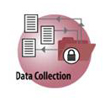
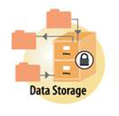



Understand where your data is
Understand Existing Methodologies
Data Inventory/Lifecycle Methodology & Process
Key Deliverable:
Data flow diagrams
?
?
?
?
27
Notes:
²⁷

Slide 28
Use Technology Where Possible
Where is sensitive data located?
What is the user doing with it?
Where is the data going?
Apply DP Policy and Actions?
Discovery
Desktops
Servers
Storage
Classification
Tagging
Content
Similarity
Keyword
Dictionary
Context
Server
Application
File Type
User
Unstructured Data
Read
Write
Copy/Paste
Move
Print
Burn
Upload
Structured Data
View
Modify
Delete
Extract
Alert
Detection
Notify
Awareness
Prompt
Intent
Encrypt
Protection
Block
Protection
Mask
Need to know
E-mail
Applications
Devices
Networks
Audit Logging
28
Notes:
28

Slide 29
Deloitte Data Protection Approach
Strategy
Strategy
Organization
Organisation
Implementation Roadmap
Policies
Implementation Roadmap
Policies
Taxonomy
Technology
Procedures
Procedures
Communications,
Communications,
Training, Awareness
Training, Awareness
Risk Assessment
Risk Assessment
Audit
Audit
Evaluation
Evaluation
And Compliance
And Compliance
And Adjustment
And Adjustment
Metrics and Reporting
Metrics and Reporting
29

Slide 30

2009 Insurance Briefing Series
Keeping you up to date
Month | Topic
February 12th | Regulatory Updates for insurers
March 10th | Hot topics for audit committees
April | Anti Money Laundering
September | Regulatory updates for insurers
October 20th | Motor insurance survey briefing
October | Annual financial reporting seminar
December | Finance Bill for financial services

Slide 31

This document is confidential and prepared solely for your information. Therefore you should not, without our prior written consent, refer to or use our name or this document for any other purpose, disclose them or refer to them in any prospectus or other document, or make them available or communicate them to any other party. No other party is entitled to rely on our document for any purpose whatsoever and thus we accept no liability to any other party who is shown or gains access to this document.
© 2009 Deloitte Touche Tohmatsu.
Deloitte refers to one or more of Deloitte Touche Tohmatsu, a Swiss Verein, and its network of member firms, each of which is a legally separate and independent entity. Please see www.deloitte.com/about for a detailed description of the legal structure of Deloitte Touche Tohmatsu and its Member Firms.
Notes:
31

Slide 32
声明：
所有的版权属于原有公司，文件均来自公开渠道
此文件仅供学习使用，任何人不得进行以此为商业目的的行为
如有疑问，请立即删除
学习世界五百强和咨询公司PPT课程请访问如下网站搜索：“司马懿”
百度传课：司马懿PPT学校
https://www.chuanke.com
网易学堂：司马懿PPT学校
https://study.163.com
知乎： 司马懿PPT学校
https://www.zhiu.com

